Slide 1
Google File System
by Mikael Bjerga & Arne Lange

Slide 2
Content
Introduction
Assumptions
Design Overview
System Interaction
Master Operations
Fault Tolerance & Diagnosis
Measurements
Conclusion

Slide 3
Introduction
Component failure is the norm rather than the exception
Today’s files are huge by traditional standards
Many files are mutated by appending to it
Appending on files is the focus of optimization

Slide 4
Design Overview

Slide 5
Assumptions
GFS is built from components that fail
monitor, detect, tolerate failure
recovery from failure
Most files are large > 100 MB or more
High sustained bandwidth more important than low latency
2 kinds of reads/writes
large streaming reads/write (appending)
small random reads/writes

Slide 6
Architecture
1 single master server
Multiple chunk server
Files are divided into chunks (fixed length)
Chunks are identified by an unique 64-bit long chunk-handle
No caching in GFS
The chunk servers are linux server and their filesystem is already caching the most prominent files
No POSIX API provided

Slide 7
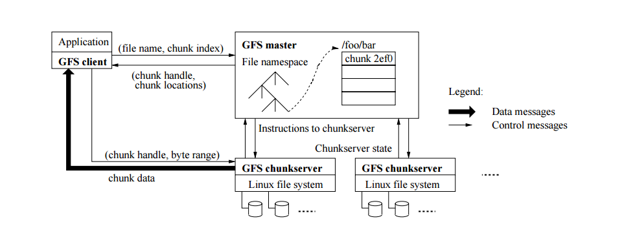
Architecture cont’d

Slide 8
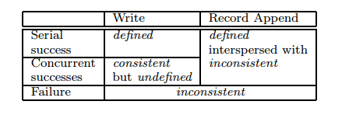
Architecture cont’d
Consistency Model

Slide 9
System Interactions

Slide 10
Leases and mutation order
Mutations alter content or metadata
Leases used to maintain consistency
One primary, multiple secondaries
Primary decides serial order of mutation application
Leases timeout in 60 seconds
Extended via Heartbeat
Leases can be revoked

Slide 11
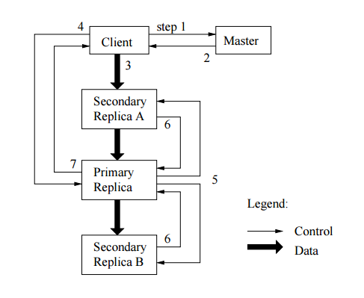
Leases and mutation order cont’d

Slide 12
Data flow
Data pushed linearly along carefully chosen chain of servers in a pipelined manner.
Linearity → Utilize full outbound bandwidth
Chosen chain → Avoid network bottleneck and high-latency links
Pipeline → Minimize latency

Slide 13
Atomic record appends
Only data specified by client
At least one atomic append guaranteed
Atomic = continuous sequence of bytes
Offset returned to client
Chunks checked before appends to not exceed 64MB-limit
No guarantee of bytewise identical replicas

Slide 14
Snapshot
An operation which copies a file or directory tree
Uses copy-on-write
Minimizes interruptions of ongoing mutations
Used to create copies of huge data sets
...or to checkpoint current state before experimentation

Slide 15
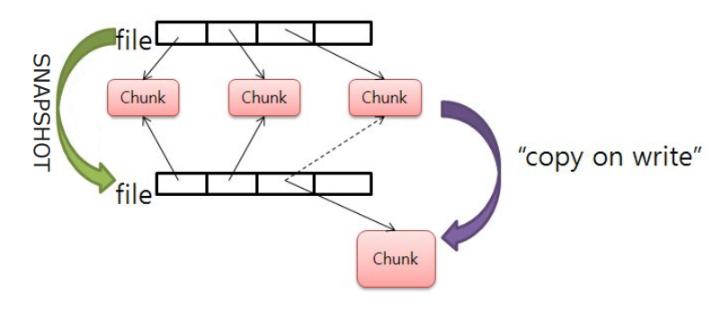
Snapshot cont’d

Slide 16
Master Operation

Slide 17
Namespace management and locking
Multiple active master operations
Locks ensure serialization
Namespace logically represented as lookup table
Namespace represented as tree in memory, using prefix compression
Short example: /d1/d2/d3/leaf
Lazy allocation of locks
Deadlock prevention using ordering

Slide 18
Replica replacement
GFS cluster contains hundreds of chunkservers across many machine racks, accessed by hundreds of clients spread across machine racks
Replicas spread across machines for reliability, availability and bandwidth utilization
Replicas spread across racks for ensure chunk survival under rack failure
Improves reads
...but worsens writes

Slide 19
Creation, re-replication and rebalancing
Creation
Prefer servers with below-average disk space utilization
Avoid many new replicas on one server
Spread replicas across racks
Re-replication
Prioritize chunks who lost many replicas
Prioritize chunks for live files
Prioritize chunks which block client progress

Slide 20
Creation, re-replication and rebalancing cont’d
Re-replication cont’d
Limit clone operations
Limit bandwidth for cloning operations
Rebalancing
Balance load
Better disk space
Gradually fills new chunkservers
Delete replica from server with below-average free space

Slide 21
Garbage collection
Lazy
Deletion logged
Renames file to hidden name
Removed after three days
Remove metadata → Full deletion
Uses Heartbeat piggybacks
Amortized cost

Slide 22
Stale replica deletion
Miss mutation → Stale replica
Chunk version number
Update version number on lease grant
Discovered in chunk-set report to master
Removed in garbage collection
Version number included when returning lease to client or cloning instructions to chunkserver

Slide 23
Fault Tolerance and Diagnosis

Slide 24
Fault Tolerance & Diagnosis
High Availability
Fast Recovery
Replication
Data integrity
Use checksums to detect data corruption
Each chunks is divided by 64 byte blocks ⇒ each block has a corresponding 32 bit checksum
Diagnostic Tools
Extensive logging on every server
Logs exact request and response
Logs used for performance analysis

Slide 25
Measurements

Slide 26
Measurements
Test setup:
chunk server
clients
Each machine:
- 2 GB of memory
- 80 GB 5400 rpm
- 100 Mbps full duplex
replica
1
1
GFS master
replica
16
16

Slide 27
Measurements cont’d
Reads
N clients read simultaneously a random 4 MB region of a 320 GB file set
Repeat 256 times ⇒ each client reads 1 GB of data
Expected hit ratio on the buffer cache in chunk server at most 10 %
Writes
N clients create N distinct files simultaneously
Each client write 1 GB to the new file in series of 1 MB writes
Record append
N clients append simultaneously to a single file

Slide 28
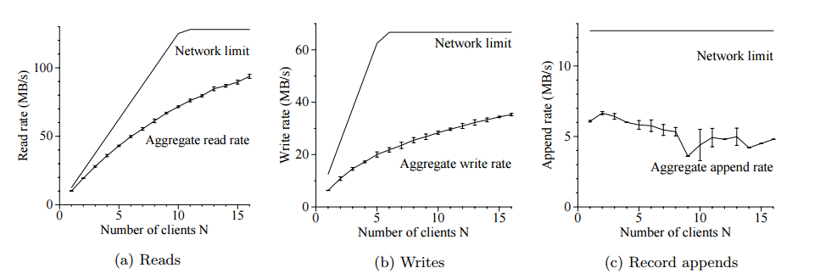
Measurements cont’d

Slide 29
Conclusion

Slide 30
Conclusion
GFS demonstrates essential qualities for supporting large-scale data processing workloads on commodity hardware
Component failure is the norm, not the exception
Optimized for huge files with appends
Fault tolerance by constant monitoring, data replication and auto-recovery
Chunk replication against server failure
Checksumming against data corruption
Separate file system control from data transfer
Minimize master’s involvement
Widely used by Google

